Slide 1
Pennsylvania Oil & Gas Landowners Alliance
Members Only Area Guide Book
An illustrated guide to getting the most out of
our interactive and self-service website

Slide 2
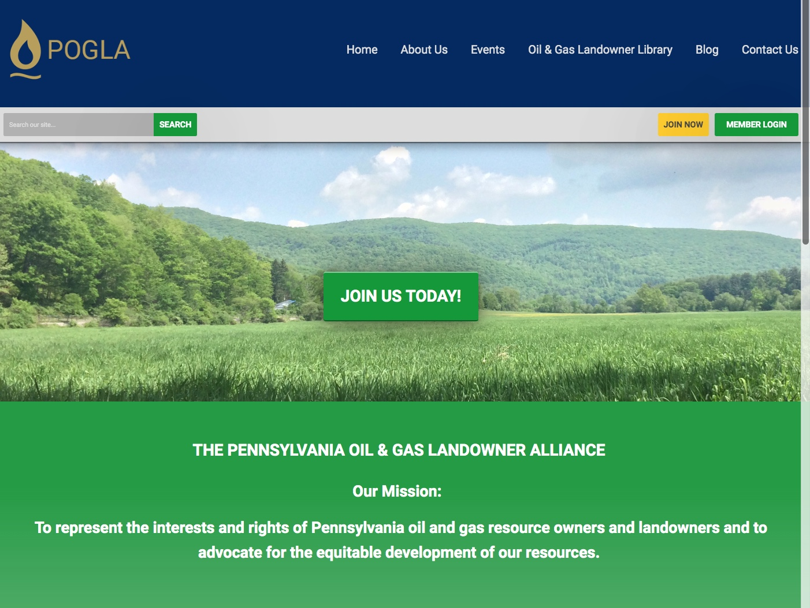
Membership Has its Privileges
Our website and our membership offers many self-service and exclusive benefits that only members and/or their employees can take advantage of
To ensure only Members receive these benefits, these areas of our site require a valid log in
The more you update and personalize your membership, the more value you will receive from us

Slide 3
New Membership Options
Most members were “grandfathered” in as basic members, but we have new options.
Contact us at membership@pogla.org to change.

Slide 4
Renewals
A member can renew their own membership in several ways:
By paying the auto-generated online Renewal invoice tied to their renewal notification
By paying the mailed invoice that is sent to you if you have not paid in 15 days.
By logging in and submitting a Renewal Form
By logging in and using the Renew option from the My Profile page
IMPORTANT : If you want to upgrade your renewal please send a message to membership@POGLA.org or call

Slide 5
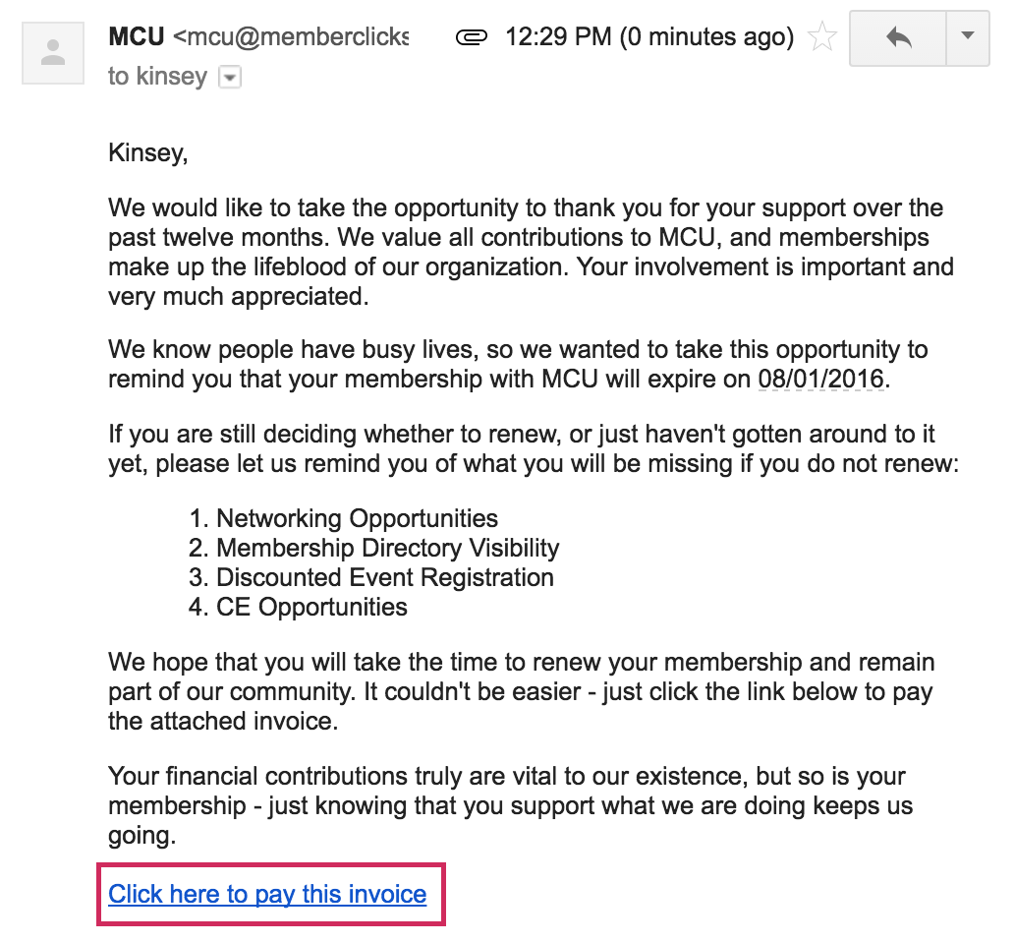
How to Renew Your Membership
Here's an example of a renewal email that will be sent directly to your personal email inbox.
By paying the auto-generated Renewal invoice tied to their renewal notification
By paying the mailed copy of the invoice
By logging in and submitting a Renewal Form
By logging in and using the Renew option from the My Profile page

Slide 6
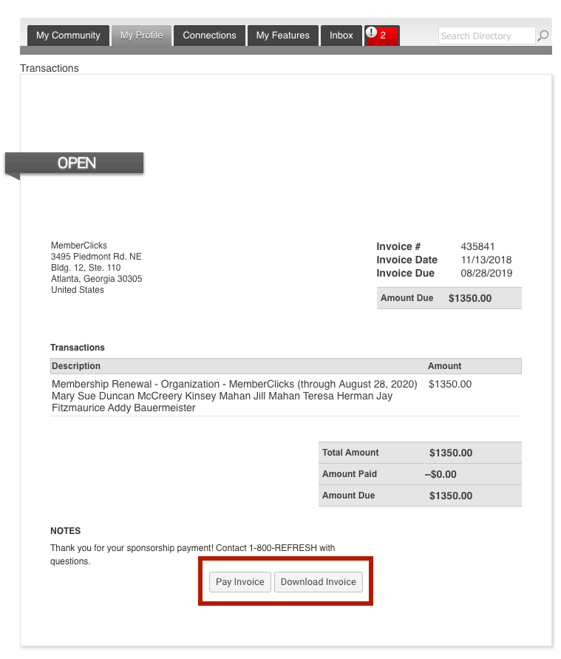
Pay Your Renewal Invoice
Once you have clicked submit. You will be taken to your renewal invoice to pay.
Paying an Invoice: Click on the button at the bottom ‘Pay Now.’ Our payment area will come up for you to enter your card and billing information.

Slide 7
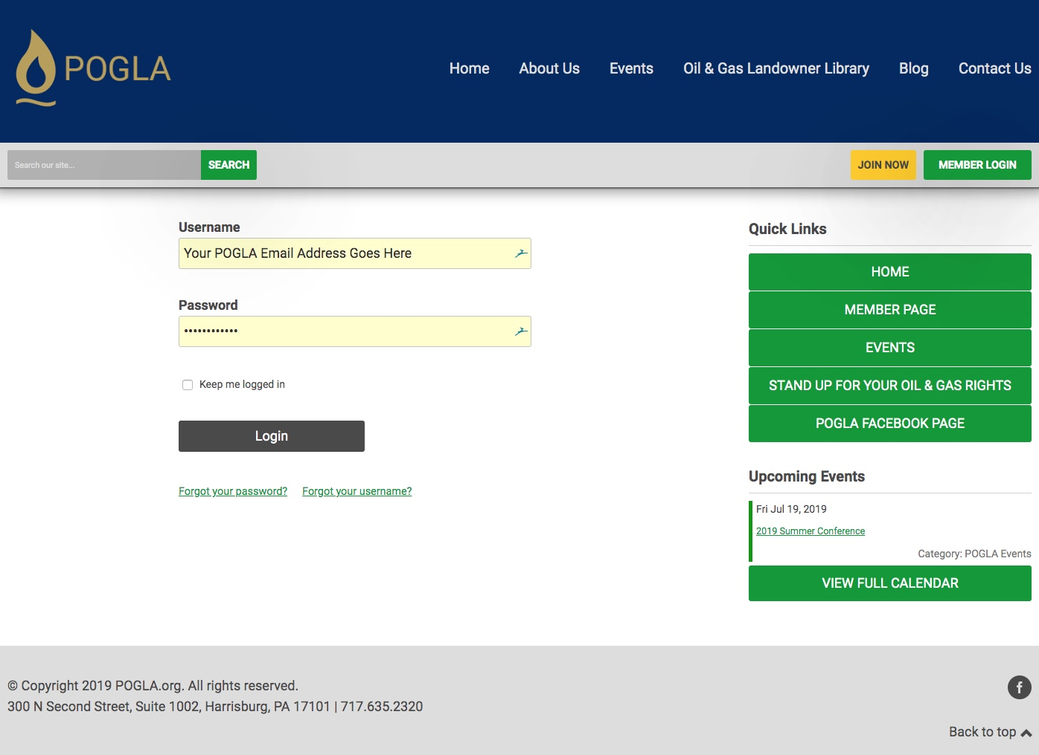
Once you have a Username and Password, you can use it to access any Members-only or restricted items, like event discounts, members events, member directory and the social community features.
Take Control of Your Membership
Your username is the email address you gave us for your membership.
If this is the first time you have signed in or if you have forgotten your password, no worries! Click ‘forgot your password’ and enter the email address associated with your profile. You will then be emailed a link to reset your password.
Note: To receive the link via email, the email address you enter must be the email address in your membership profile.

Slide 8
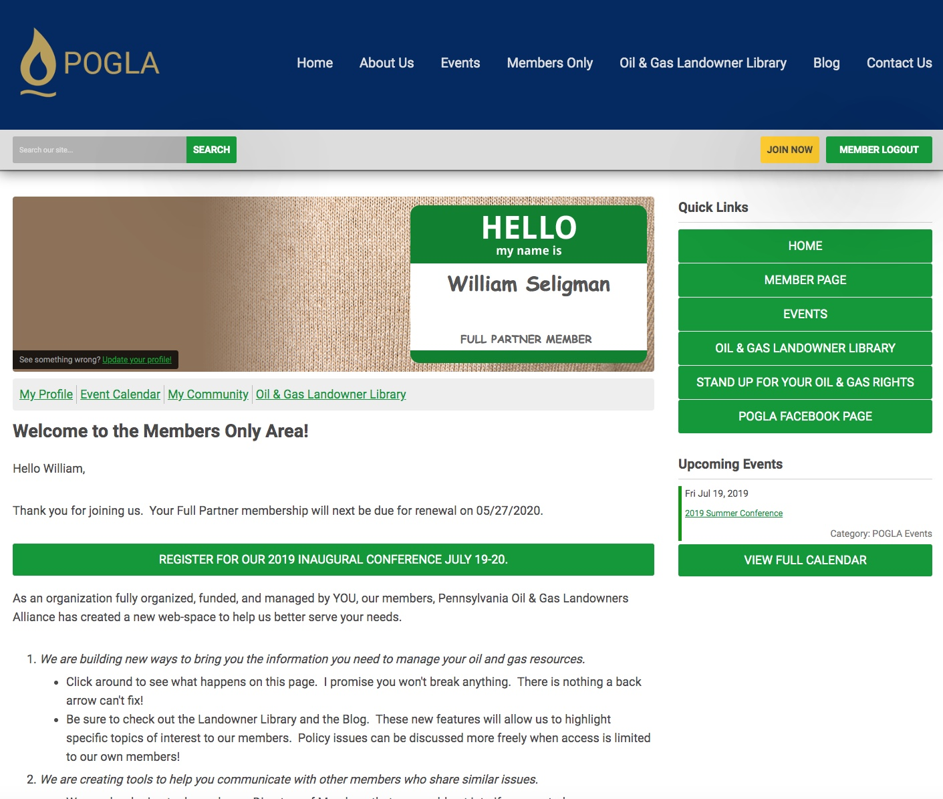
What Can I Do with the website?
View your profile
View/ Pay Invoices
Access the Member Directory
View the Event Calendar
View any members only content on this website
Interact and connect with other members? Lets get back to this.

Slide 9
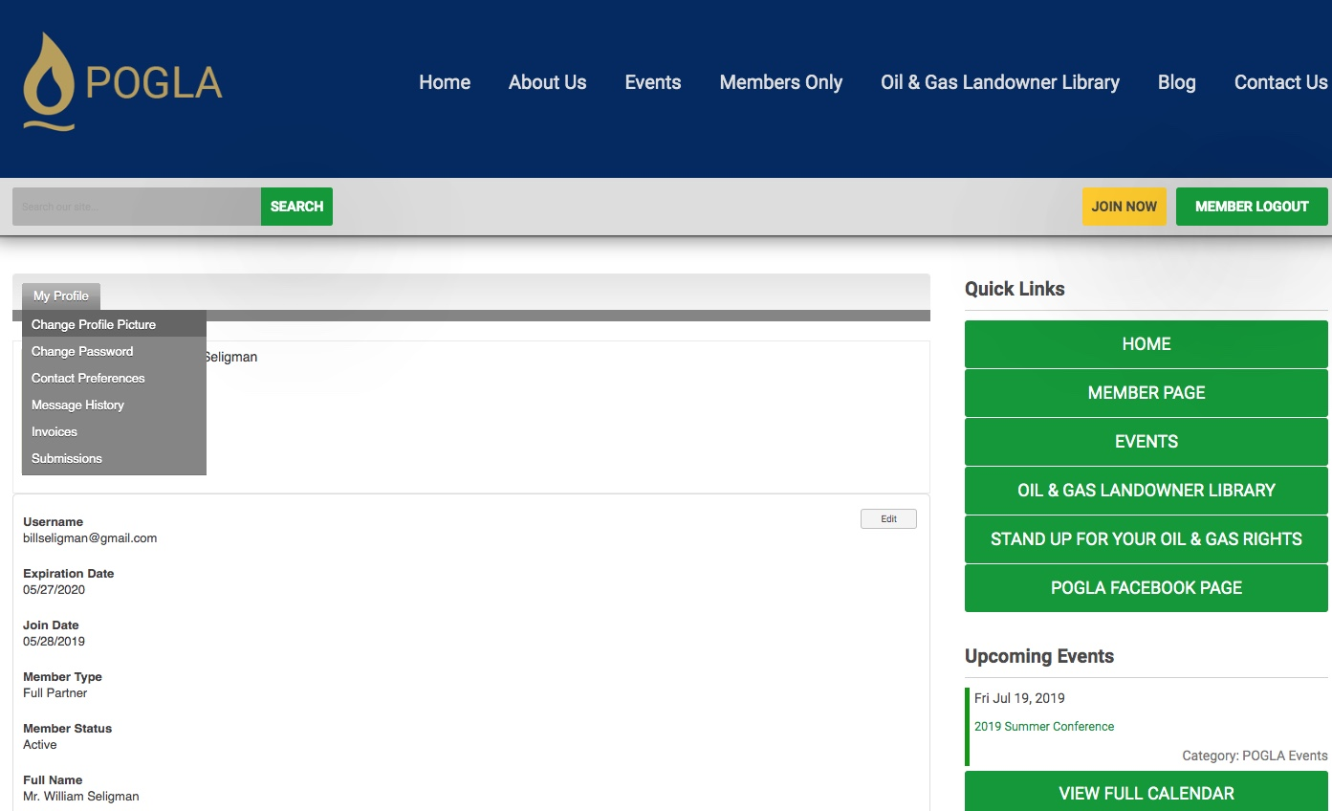
Hover the words ‘My Profile’, to make additional changes to your profile.
Change your profile picture
Edit your privacy settings
Change your password
Manage how we contact you
View past emails we have sent to you
View a list of all your invoices
View all forms that you have submitted

Slide 10
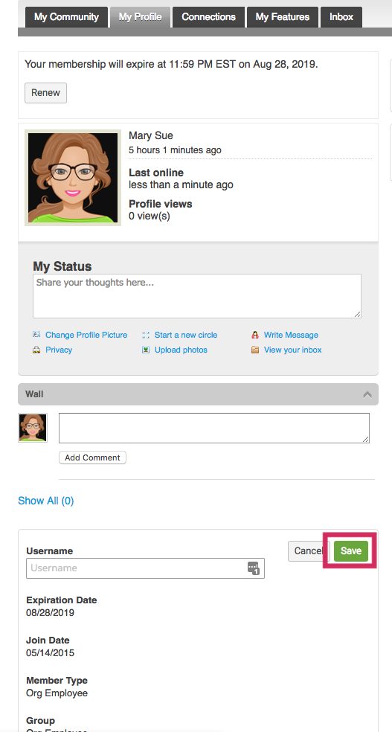
My Profile
These fields show you what information we have now. Please fill in any blanks so that we can know you as well as possible.
Information here can be used on your Directory listings or for communications we send out.
Make sure to click Save at the end of the process.

Slide 11
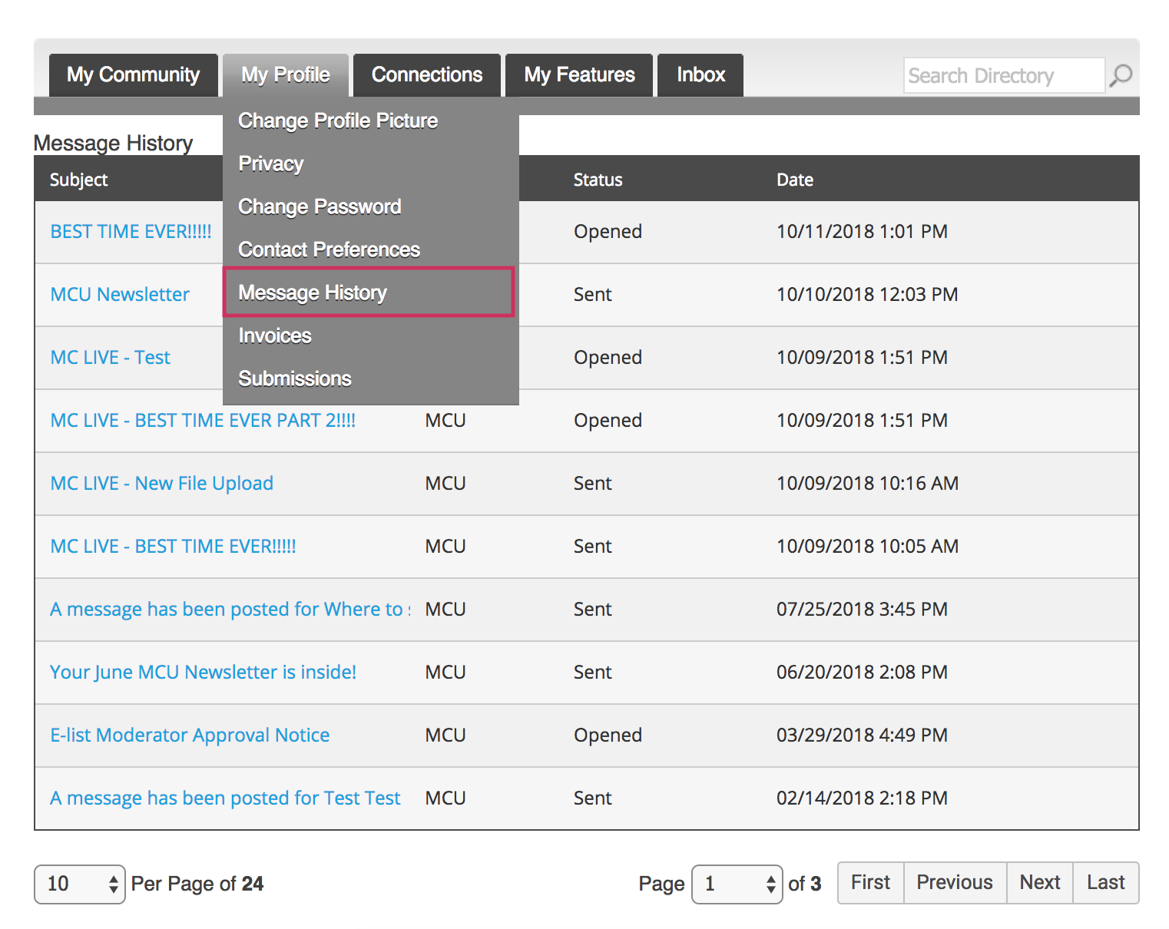
Message History
The Message History area will show you all of the emails the organization has sent to your personal inbox. If you ever delete an email, there is a full record kept in this area of your profile. Click on the subject line to open the body of the email.
Having a hard time receiving emails? Let us know.

Slide 12
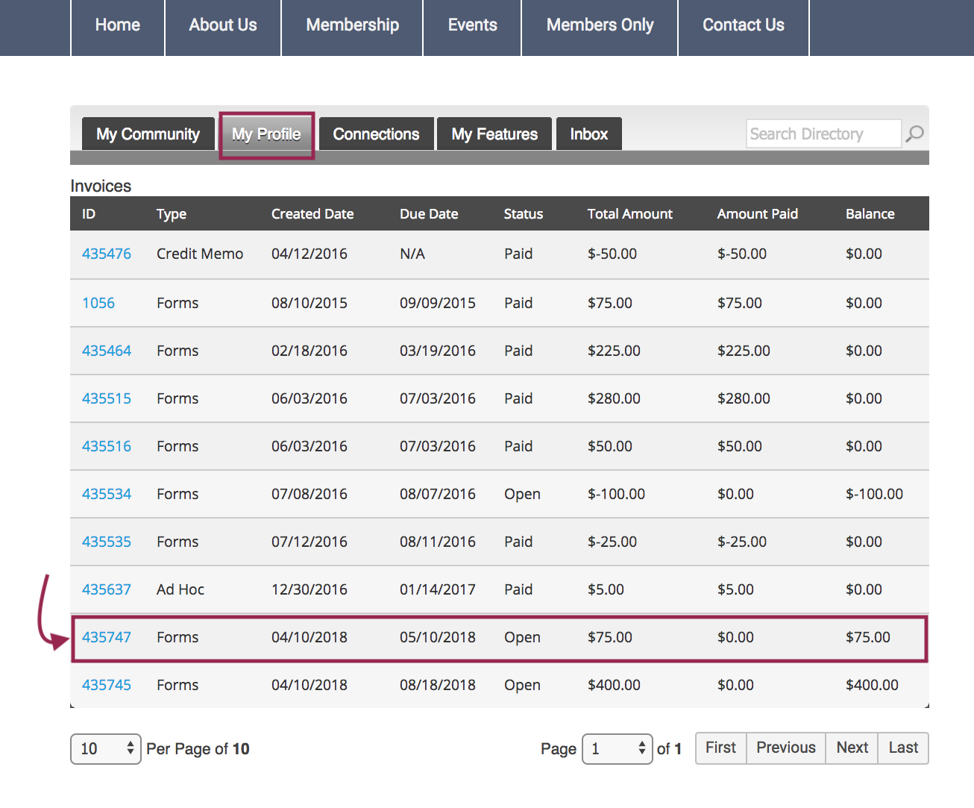
View your Invoices
Under ‘My Profile’ you have the ability to display your invoices.
This area will show you past paid invoices and open invoices that you are able to pay.
To open any of these invoices, simply click on the Invoice ID to view the invoice.

Slide 13
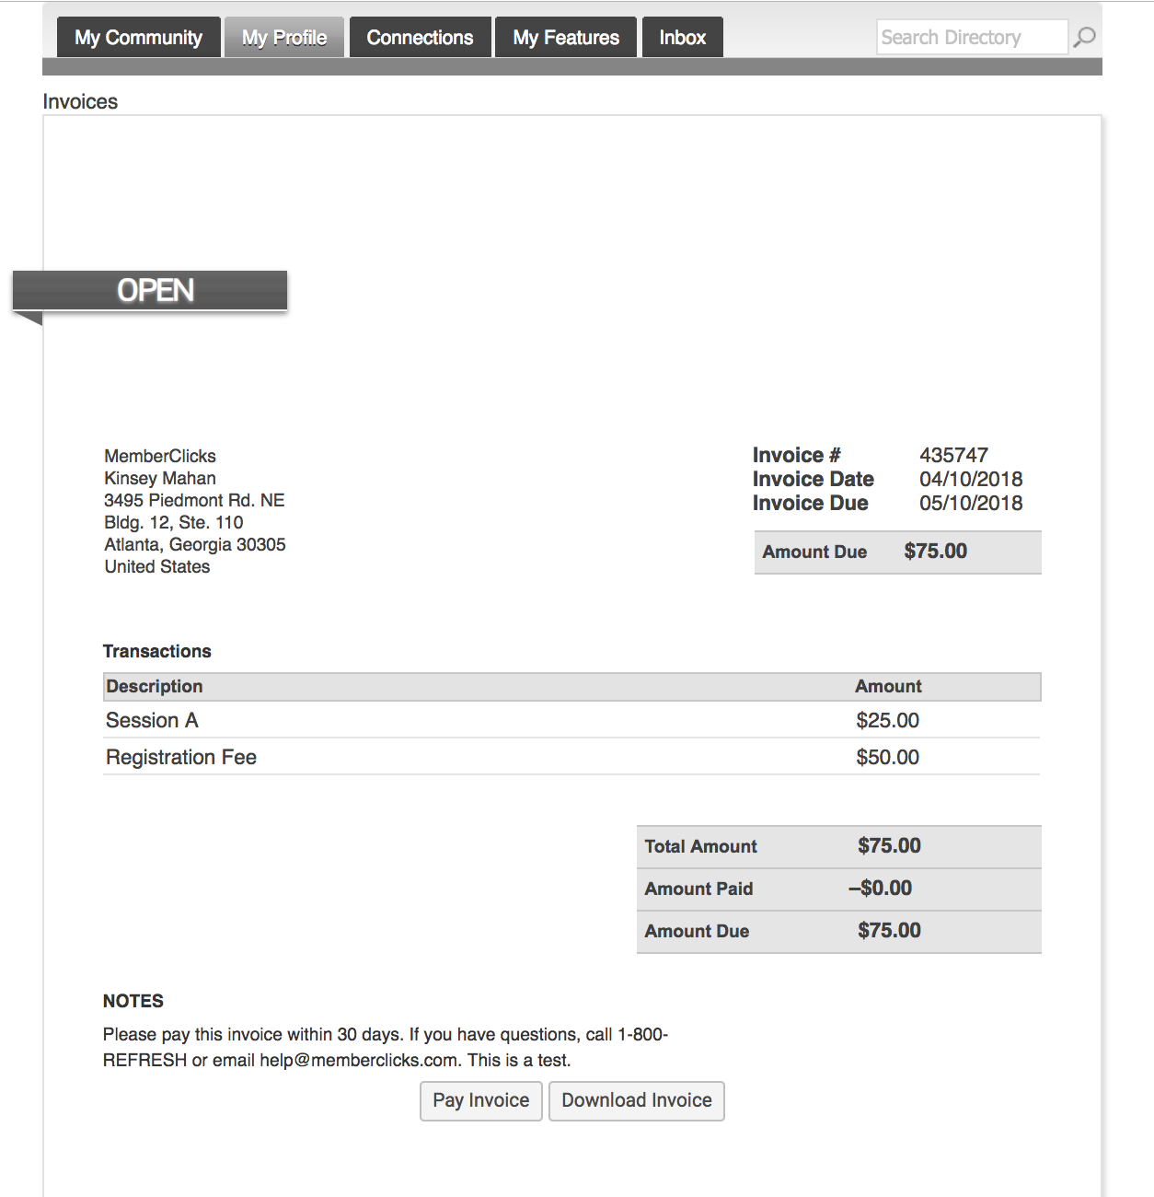
Pay Your Invoices
Once you have clicked on the Invoice ID you have the option to pay an open invoice or download an invoice.
Paying an Invoice: Click on the button at the bottom ‘Pay Now. Our payment area will come up for you to enter your card and billing information.

Slide 14
The New POGLA Landowner Library

Slide 15
Events Calendar

Slide 16
Future Directions: Directory Search?

Slide 17
Future Directions: Member Community?

